Slide 1
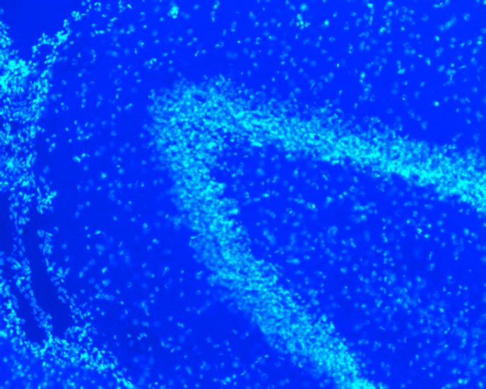
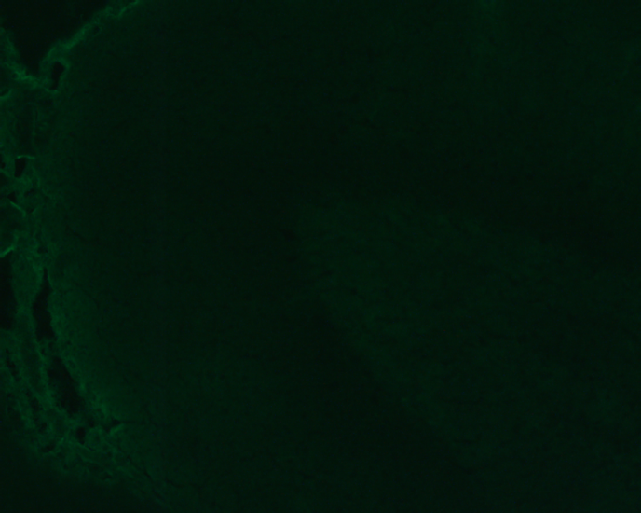
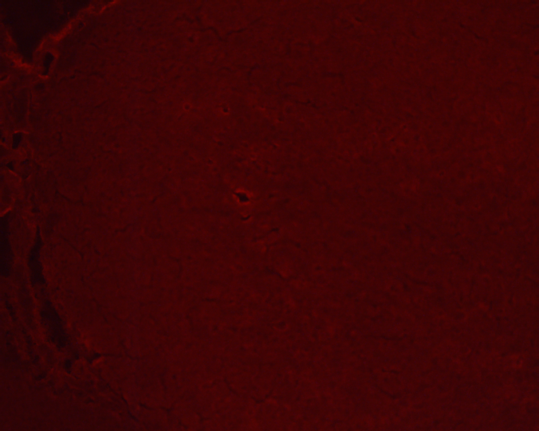
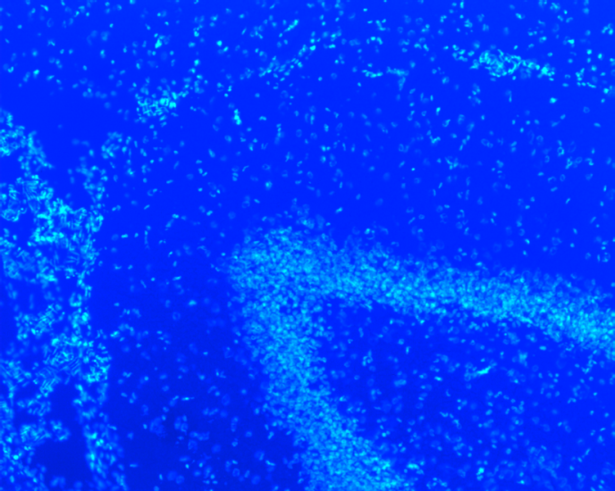
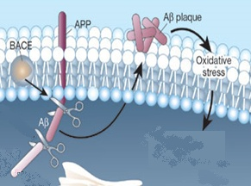
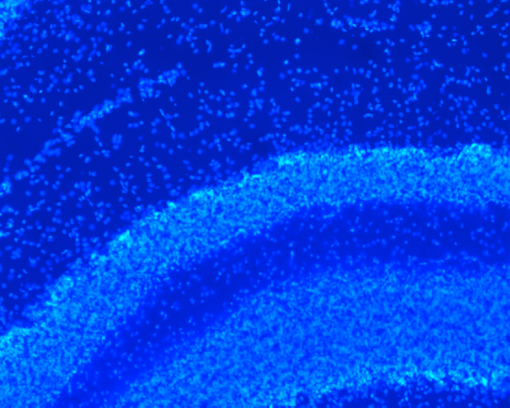
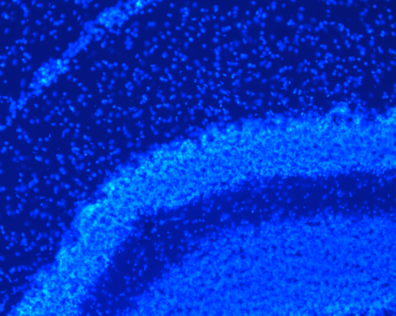
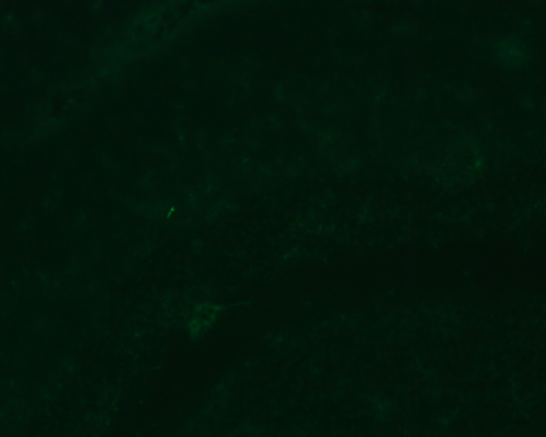
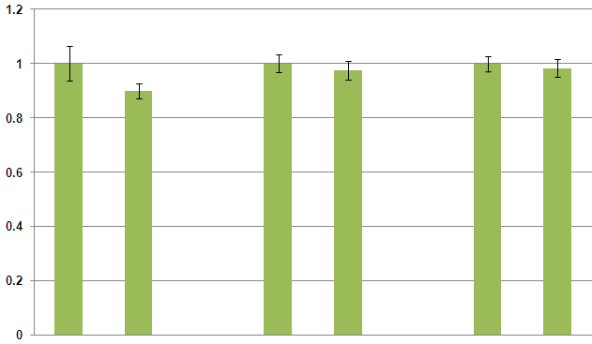
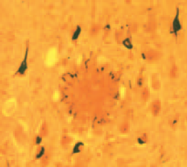
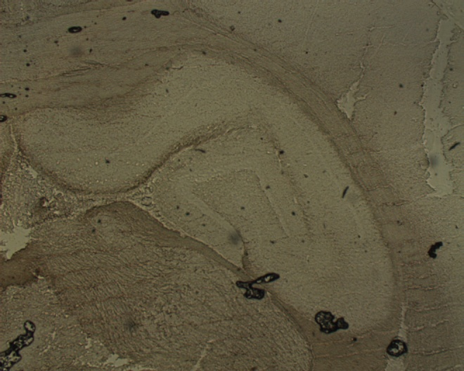
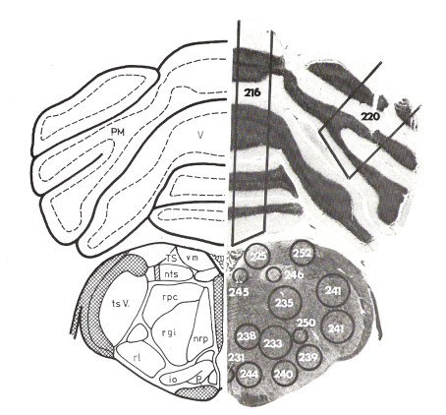
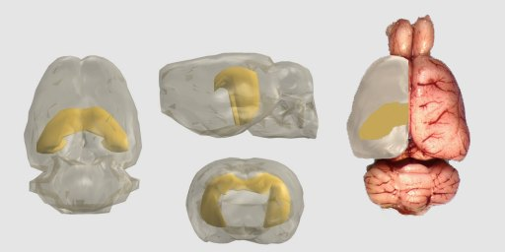
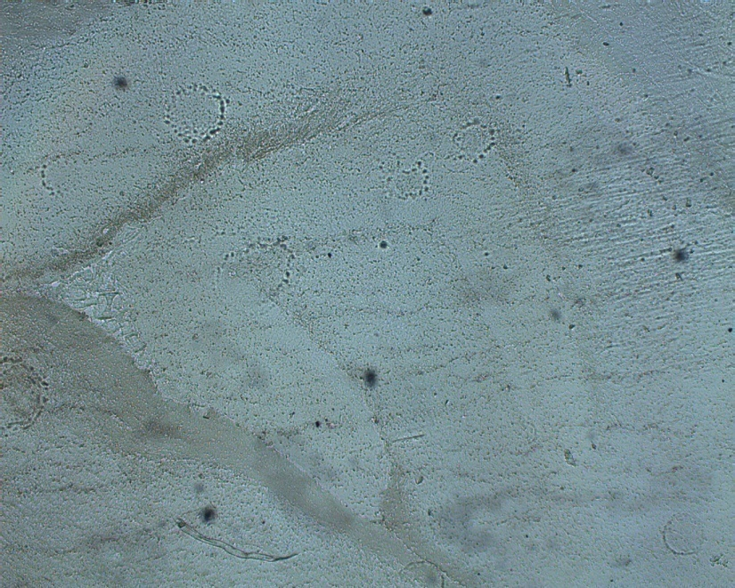
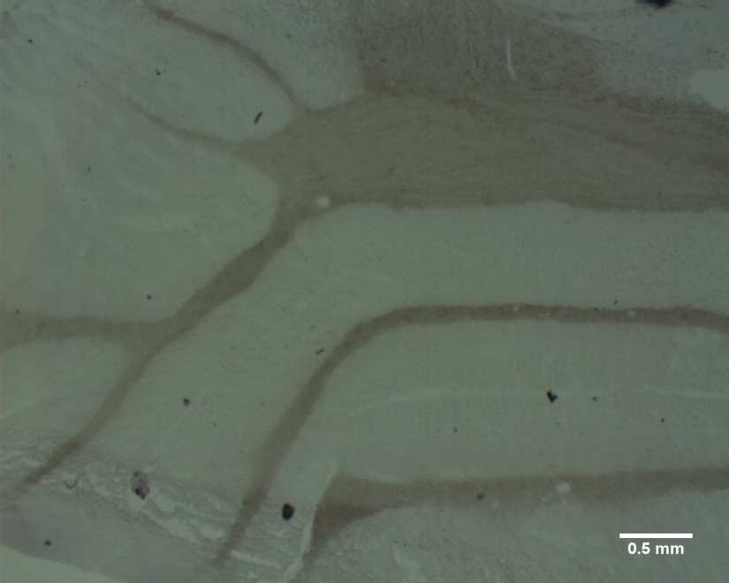
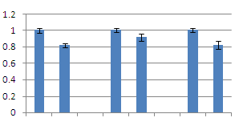
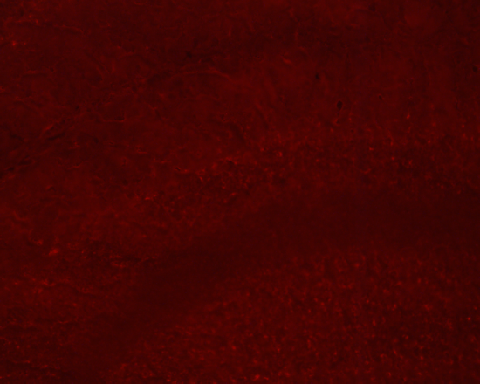
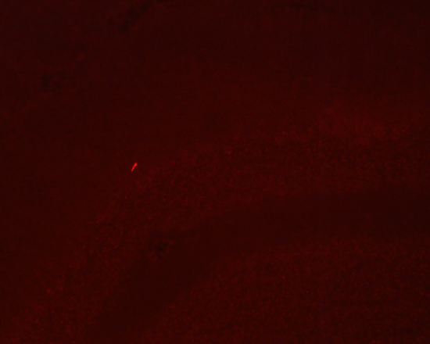
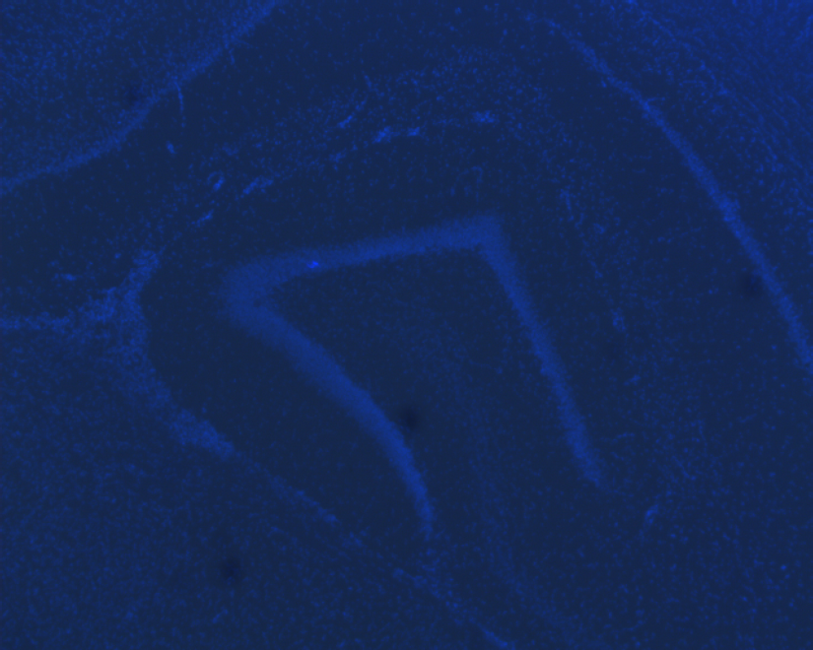
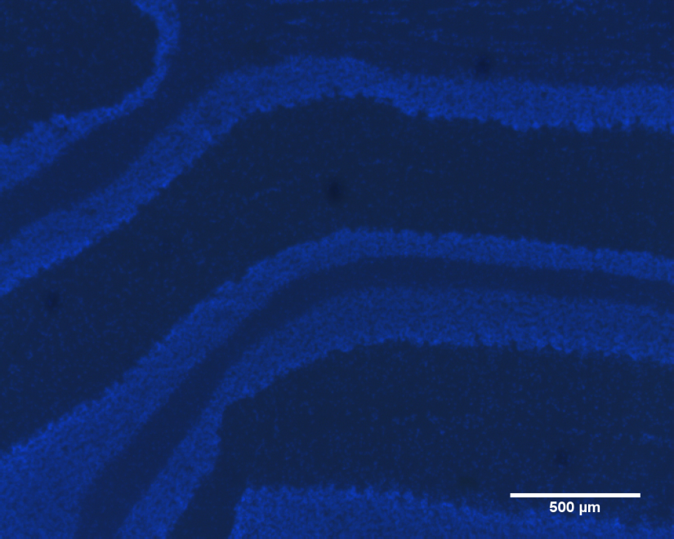
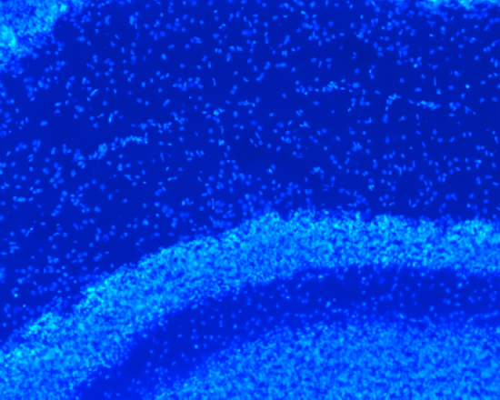
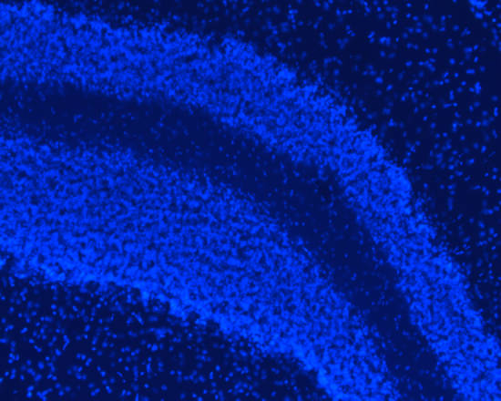
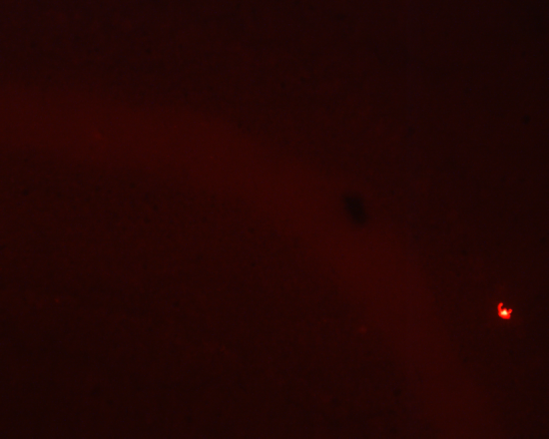
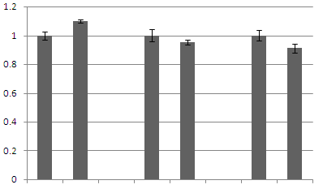
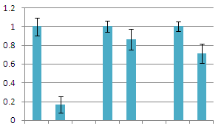
Introduction: Oxidative damage of bio-molecules and tissues is a well accepted mechanism and outcome of aging. In addition, when animals age neurological function is generally diminished, this is called senescence or cognitive impairment and may correlate with formation of senile plaques (SP) as seen in figure 2A (8). In reference 2 a transgenic mouse model (for human Alzheimers disease(AD)) is used, the author Apelt showed that increased brain oxidative stress seems to have an important role in cognitive impairment caused by normal aging and neurodegenerative diseases. She goes on to assert that her study demonstrates time correlation of SP formation with the highest levels of anti-oxidant enzymes. However, this and other studies have shown the patterns of age-related expression of SOD and other anti-oxidant enzymes (i.e. glutathione peroxidase (Gpx)) in brain pathology and aging to be unclear. Overall, these enzyme activities increases with age, Gpx activity has been shown to increase in AD. Furthermore, levels of SOD increase with age up to the 21st month in mice but after then to level off, which implies that oxidative damage may eventually outstrip the tissue’s ability to enzymatically respond (2). Amyloid-beta proteins (Aβ) are a major component of SP in both AD brains and non-diseased aged brain (1). As seen in figure1A, BACE1 (beta amyloid precursor protein cleaving enzyme) cleaves amyloid precursor protein (APP) to yield Aβ; these proteins in turn form amyloid or senile plaques. Activity of the enzyme BACE1 does precede and seems to correlate with the appearance of SP (7). Inflammatory cytokines from microglia seem to up-regulate BACE1 (6) while the presence of SP can cause an increase in local glial cell mediated inflammation (fig 1B). Additionally, neither AD model nor normal mice seem to exhibit a negative feedback loop by which the BACE1 product Aβ controls BACE1 activity (2). In total, these relationships seem to form a runaway feed-forward loop that results not only in increased tissue oxidation and Aβ formation but also the formation of SP (2,6).
Comparative Study of Mn-SOD and BACE-1 Expression and Distribution in Adult and Aged F344XBN rat Brain
Srinivasarao Thulluri, David Neff, Michael Norton and Bin Wang: Chemistry Dept. Marshall University
Abstract:
Reduction of cellular expression and activity of antioxidant proteins and the resulting increase of oxidative stress are important causes of the aging processes and neurodegenerative diseases. Specifically the aging mammalian brain shows alterations in expression of two superoxide dismutase enzymes (SOD-1 & SOD-2) and a β- secretase called β-site amyloid precursor protein cleaving enzyme (BACE1). BACE1 and SOD1 have been implicated in a cycle that leads to focal glial activation and coincides with increased BACE1 expression and results in amyloid plaque deposition (as seen in Alzheimer’s pathology). In the present study, we monitor expression and distribution of these proteins (SOD2 and BACE1) in the brains of young (6 month old) and aged (33 month old) rats by using immunohistochemistry and fluorescence microscopy of frozen tissue sections. As the relationships of these enzymes is not entirely clear in the current literature, we map the relative distribution of BACE1, and SOD-2 in whole rat brain sections, focusing on expression levels in cerebellum and hippocampus.
6 month age group only
Results:
1- Figure 3 shows hippocampus sections from only 6 month old rat. Due to poor section quality, we could not be positive of location of hippocampus in sections from the 33 month animals. Although there is obvious non-specific binding of secondary antibody to sections (E&F) we see in B & C signal that is more intense. In the case of the anti-BACE1 probe (B) we see more BACE1 signal in the region indicated by white arrow.
2- Cross sections of cerebellum stained with BACE 1 and SOD 2 antibodies were clearly demarcated in to white matter, granular layer and molecular layer as labelled with letters W,G and M respectively (Figure 4&5).
3- Intensity of flourescence emitted by probes for BACE1 & SOD2 was quantified using Image J software. The results were analyzed with one-way ANOVA and the data plotted in to graphs as shown (Figure 4E,5J,5K& 5L). Bars show standard error. All data displayed graphically has been scaled to show expression levels (relative to 6 month levels) between age groups within a given tissue type and antibody. For this reason we cannot use these graphs to compare intensity of fluorescence between tissue types. Images in figures 4&5 show that intensity of BACE1 and SOD2 labels varied notably between white matter, granular layer and molecular layer, predominantly appearing in the granular layer (highest density of cell bodies).
4- With aging we measured no significant change in expression of BACE1 in white matter of cerebellum between adult 6 months and aged 33 month F344XBN rats. Similarly, the expression of BACE 1 in granular layer and molecular layer of cerebellum is not changed with aging in F344XBN rat model.
100 µm
A
B
C
with1° Ab
100 µm
D
E
F
no 1° Ab
Figure 3. Expression of BACE1 & SOD2 in Hippocampus. A and D are DAPI stain showing cell nuclei for anatomical context. B & C were exposed to primary antibodies against BACE1 and SOD2 respectively. E & F are micrographs showing negative controls of the same anatomical region without exposure to BACE1 & SOD2 primary antibodies.
Inflammation (cytokines+ROS)
5- Figure 5 shows decrease in SOD2 signal in all cerebellar tissue types (J). However, 5K shows that in the absence of primary antibody we still see age dependent variation in secondary Ab signal. Aging leads to decrease in non-specific signal in granular and molecular layers and a increase in non-specific signal from the white matter.
6- Figure 5L shows intensity data that has been normalized by subtracting the age related changes in non-specific secondary Ab binding. Compared to 6-month animals, the relative expression of SOD2 in cerebellum decreased by 84% and 29% in white matter and molecular layer respectively in 33-month old rats. Interestingly there is no significant difference in the expression of SOD 2 in Granular layer
neuron
Increased activity of microglial cells
Up-regulation of SOD
BACE1 up-regulation
A
SOD
B
Senile plaque formation
Control of ROS
Wolozin, PNAS 2001;98:5371
Adapted from; Kukar Nature 453:925(2008)
Cleavage of APP
E
Figure 1 A. Diagram adapted from Wolozin and Kukar showing the role of beta- secretase (BACE1) in SP formation. These SPs are found in special abundance in hippocampus of AD patients and throughout the cortex in lower numbers in non-diseased aged animals. At right (1B) is a diagram summarizing the feed forward effect that has been suggested by Sastre in reference 6 and Apelt in reference 2. It shows the relationship between anti-oxidant enzymes (SOD), SP formation, and BACE1 expression and highlights our present ignorance as to the nature of direct causal links between these biochemical and histopathological factors.
6 month
33 month
D
100 µm
A
B
M
C
6 month
M
33 month
6 month
with1° Ab
G
G
6 month
33 month
Figure 2 A: Histopathology of human brain; β-Amyloid plaque 50-100um (black arrrow), normal appearing neurons (grey arrow) and neurons containing neurofibrillary tangles (white arrows). B depicts a 3D reconstruction of the rat brain (hippocampus in yellow). Blue boxes are the approximate locations from which we took our frozen sections. C and D are unstained transmitted light micrographs of one of our sections taken from rat cerebrum, white arrows point to hippocampus, blue arrow points to the corpus collosum. Corpus collosum, mostly myelinated axons, appears white in intact brain so we used this structure to help us establish orientation and position within the brain during sectioning. E is a DAPI stained UV fluorescence image of same region as in D, nuclei appear bright against back-ground.
Haass C Nat Rev Mol Cell Biol 2007;8:101
C
F
W
W
33 month
White matter
Granular layer
Molecular layer
Figure 4. Expression of BACE1 in cerebellum. A&B (6 month), C&D (33month); micrographs showing expression of BACE1 in white matter (W ), Granular layer (G ) and Molecular layer( M). E is bar graph showing intensity of BACE1 expression quantified by using Image J software. In all cerebellar tissue types, we find no significant difference with aging in BACE1 expression n=6.
A
0.5mm
G
http://synapses.clm.utexas.edu/anatomy/hippo/hippo.stm John C.Fiala
frontal cortex
Parietal cortex (arrow) and hippocampus (in gold)
D
6 month
33 month
100 µm
A
B
C
D
J
100 microns
6 month
M
33 month
6 month
B
M
6 month
33 month
cerebellum
500um
with 1° Ab
G
W
G
33 month
F shows a plate from ref 9 that we used as a guide to identify the area of the cere-bellum from which we took our frozen sections. All micrographs of cerebellum were taken from structures of the vermis (V), the red box gives approximate location of the section imaged in G. The white box in G identifies the area shown in H. The following key for the labels in H identifies histological regions within the cerebellum that were analyzed for antigen/antibody activity.
E
H
W
100 µm
E
F
G
H
I
White matter
Granular layer
Molecular layer
white matter, mostly myelinated axons
M
W
K
granular layer, high density of small neurons known as cerebellar granules
no 1° Ab
molecular layer , fewer cells, many un-myelinated axons
500um
G
W
6 month
M
33 month
6 month
6 month
33 month
Materials and methods:
33 month
primary Antibody | Primary antibody dilutions in PBST/BSA | secondary antibody | Secondary antibody dilutions in PBST/BSA
Mouse monoclonal IgG1(BACE1) | 1:100 | Fluorescein Anti-Mouse igG (H+L),made in horse,from Vector Labs Catalog no.F1-2000 Stock concentration 1.5mg in 1ml (10mM HEPES,.15M NaCl,pH7.5,0.08%sodium azide) | 1:1000
Polyclonal raised in rabbit (SOD2) | 1:100 | Texas Red Anti-Rabbit IgG (H+L), made in goat Vector Labs. Catalog number TI -1000 Stock concentration 1.5 mg in 1 ml(10mM HEPES,.15M NaCl,pH7.5,0.08%sodium azide) | 1:500
L
White matter
Granular layer
Molecular layer
33 month
6 month
6 month
Figure 5. Expression of SOD 2 in cerebellum. Micrograph A&B (with primary antibody 6month),C&D (with primary antibody 33month),E&F (without primary antibody 6 month),H&I (without primary antibody 33 month) showing expression of SOD2 in white matter (W ), Granular layer (G ) and Molecular layer(M ). Bar graphs showing intensity of SOD 2 expression quantified by using Image J Software. There is no significant difference with aging in SOD 2 expression in granular layer. n=12
6 month
33 month
33 month
Table above shows antibodies used Animals: F344XBN rats
Tissues: flash frozen brain sectioned in cryostatic microtome (cerebellum and hippocampus)
Solutions:
Phosphate buffered saline (PBS) preparation: 8.5gm of NaCl +1.335gms of Na2HPO4+0.205 gms of NaH2PO4 in 1L Millipore H₂O
Phosphate buffered saline Tween(PBST): 0.05%PBST was prepared by adding 250µl Tween to 500ml PBS solution.
PBST/1% BSA (bovine serum albumin): 60mg of BSA was added 6ml PBST to prepare 6ml of PBST/1%BSA 3% paraformaldehyde: 3 grams of paraformaldehyde was added to 100ml PBS, heated to ~60 deg.C with constant stirring, pH raised to ~8 with KOH to allow dissolution. Stored at ~4 deg. C in brown glass bottle. Check for polymerization (white suspended material) before use.
Slides: .1% poly-L-lysine stock solution is diluted to .01% in water, slides briefly immersed in solution and air dried overnight. Mountant : Vectashield (Vector Labs) hardset mounting medium with DAPI to counterstain nuclei.
Method: -Brains were flash frozen by the following method;
Tissues were placed in Kreb’s solution for preliminary dissection. Brains were submerged in liquid nitrogen (LN2) sorted by age, placed in glass bottles and stored in -80C freezer.
-Brains were placed in -20C freezer >= 24 hours before preparing for cryo-sectioning to allow equilibration to cryostat temp.
-Tissues were attached to microtome chuck with OCT compound and further OCT was added to stabilize, and embed the tissue for sectioning.
-For cutting step, mount the frozen tissue on the cryostat holder.
-Allow frozen blocks to equilibrate in the cryostat chamber for minimum of 10 minutes, more time is better. 30µ thick brain tissue sections were prepared and mounted on poly-L-lysine coated slides. The best sections are usually obtained when the block temperature is around -15°C. The brain tissue sections were stored in a slide box at ~-15°C for up to 7 days. Any sections directly compared in this study were sectioned on the same day.
-The sections were fixed by immersing in 3% paraformaldehyde in coplin jar for 30 minutes at room temperature.
-After that the slides were rinsed in PBST for one minute and for one minute in PBS. We carefully air dry for ~20 sec and draw boundaries around sections using a liquid blocker pen (Fisher),we let it dry for a few seconds and rinse in PBS for one minute.
-Shakeoff extra PBS and sections are pre-treated with PBST/1%BSA for about 30 minutes to block non-specific antibody interaction.
-After that the sections were rinsed in PBST for 30 sec and shaked off extra PBST.
-Primary antibodies (see table above) were added (diluted in PBST/1%BSA) directly onto the sections. Added up to 100ul to cover the entire tissue at once and to prevent drying and fracturing of the sections due to the surface tension of the solution.
-Incubated in a humid chamber with rocking for one hour at room temperature.
-Wash the sections gently in PBST twice each time for two minutes and then shake off extra PBST.
-Without letting the sections dry out, we add the secondary antibody (see table above) diluted in PBST/1%BSA. Incubated as before for one hour.
-We wash the sections twice with PBST and twice more with PBS (two minutes each wash)
-Wick with kimwipe and shake off the extra PBS .
-Mount coverslips with mounting media, Vectashield aqueous hardmount with DAPI to stain cell nuclei (if preservation of sections for later imaging is required, coverslips should be sealed with epoxy to prevent drying of sections )
-We read the slides using a Nikon Diaphot300 fluorescence microscope with high pressure Hg lamp, the following filters were used: Blue cube with excitation filter 465-495nm, emission filter 515-555nm Green with excitation filter 510-560nm and emission filter 590nm long pass. UV cube 340-380nm ex., 420nm long pass emission. -We captured images with a Leica DFC280 color camera, saved as 24-bit RGB bitmaps and processed with ImageJ (v. 1.38 from NIH).
White matter
Granular layer
Molecular layer
Discussion:
Advanced age is associated with increases in the formation of inflammatory cytokines leading to upregulation of BACE 1 which cleaves amyloid precursor protein (APP) causing senile plaque formation. Senile plaques formed with aging causes increased activation of microglial cells, in turn leading to release of inflammatory cytokines and reactive oxygen species (ROS). To counter act this effect microglial cells upregulates the activity of SOD 2 scavenging ROS by anti-oxidant activity. Here in this study we hypothesized that increasing age in F344XBN rats is associated with altered expression of BACE1 and SOD2. Cerebellum of brains obtained from adult 6 month and aged 33 month F344XBN rats were sectioned (30µm) and performed Immunohistochemistry using BACE 1 and SOD 2 primary antibodies Intensity of flourescence emitted by BACE 1 & SOD 2 was quantified by using Image J software ,. The localization of BACE 1 and SOD 2 is clearly demarcated in to white matter, granular layer and molecular layer in the cerebellum of both age groups. There is no significant difference in the intensity of BACE 1 expression in cerebellum with aging in F344XBN rat model. In contrast the expression of SOD 2 was significantly decreased by 84% and 29% in white matter and molecular layer of cerebellum of 33-month old rats respectively compared to 6-month animals, while remain unchanged in granular layer.
These data suggest that aging in F344XBN rats is associated with alterations in expression of SOD2 in cerebellum leading to diminished scavenging of ROS. Nevertheless, further analysing these samples with western blotting for the expression of BACE 1 and SOD2 would confirm these findings and give a further idea of molecular mechanism underlying age associated senile plaques formation.
References:
1. P. L. Heilbroner and T. L. Kemper, Acta Neuropathol (1990) 81:60-651
2. Jenny Apelt, Marina Bigl, Patrick Wunderlich and Reinhard Schliebs , International journal of Developmental neuroscience volume 22,Issue7 November 2004, Pages 475-484
3. Hiroaki Fukumoto,t Asano Asami-Odaka, Nobuhiro Suzuki,t Hiroyuki Shimada,Yasuo Ihara,11 and Takeshi Iwatsubo* Amneican journal of Pathology, Vol. 148, No. 1, January 1996
4. Neurochemical Research, Vol. 29, No. 6, June 2004 (© 2004), pp. 1287–1297 Walter J. Lukiw1,2
5 . Jillian J. Kril · Smita Patel · Antony J. Harding · Glenda M. Halliday Acta Neuropathol (2002) 103 :370–376
6. Magdalena Sastre,Ilse Dewachter, Gary E. Landreth,Timothy M. Willson, Thomas Klockgether, Fred van Leuven, and Michael T. Heneka1 The Journal of Neuroscience, October 29, 2003-23(30):9796 –9804
7. Michael T Heneka, Magdalena Sastre, Lucia Dumitrescu-Ozimek, Ilse Dewachter, Jochen Walter, Thomas Klockgether, and Fred Van Leuven J Neuroinflammation. 2005; 2: 22. Published online 2005 October 7. doi: 10.1186/1742-2094-2-2200
8. Haass, C., Nat Rev Mol Cell Biol 2007;8:101-112.
9. Miklos Palkovits, Michael Brownstein. Maps and Guide to Microdissection of the Rat Brain.Elsevier, NY 1988.
Acknowledgements: Grant support for this study was provided by WV- EPSCoR to Bin Wang. Imaging facilities are maintained at Marshall University by MBIC http://www.marshall.edu/mbic/.

